Slide 1
Study Group
#3: Start Training
Speaker: Lindy Zhai, Mindy Lee
University of Toronto Machine Intelligence Team

Slide 2
What to expect?
Recap
This week’s content
Quizzes (Q&A)
General Q&A sessions
Notes:
This is the first session so we will take it easy and go through some details regarding the curriculums and what is coming next. But I can assure you the following sessions are going to be far more interesting and you can expect a lot of extra fun details that was not included in the lectures.

Slide 3
Recap;
Notes:
This is the first session so we will take it easy and go through some details regarding the curriculums and what is coming next. But I can assure you the following sessions are going to be far more interesting and you can expect a lot of extra fun details that was not included in the lectures.

Slide 4
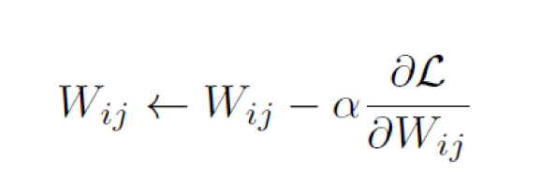
Gradient_descent;
Notes:
This is the first session so we will take it easy and go through some details regarding the curriculums and what is coming next. But I can assure you the following sessions are going to be far more interesting and you can expect a lot of extra fun details that was not included in the lectures.

Slide 5
Continue;
Notes:
This is the first session so we will take it easy and go through some details regarding the curriculums and what is coming next. But I can assure you the following sessions are going to be far more interesting and you can expect a lot of extra fun details that was not included in the lectures.

Slide 6
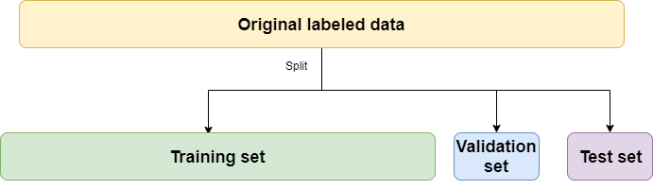
Training_Validation_Testing;
Notes:
This is the first session so we will take it easy and go through some details regarding the curriculums and what is coming next. But I can assure you the following sessions are going to be far more interesting and you can expect a lot of extra fun details that was not included in the lectures.

Slide 7
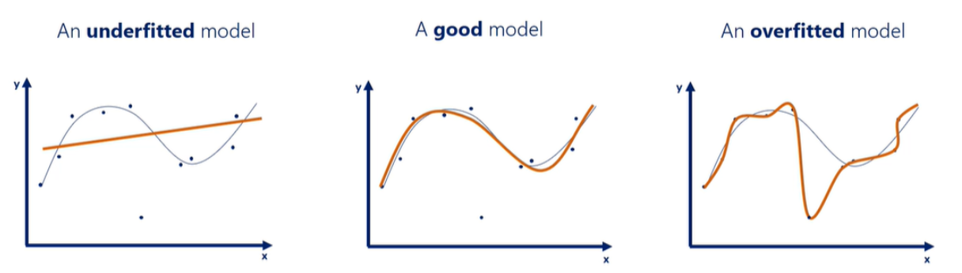
Fitting_Models;
Notes:
This is the first session so we will take it easy and go through some details regarding the curriculums and what is coming next. But I can assure you the following sessions are going to be far more interesting and you can expect a lot of extra fun details that was not included in the lectures.

Slide 8
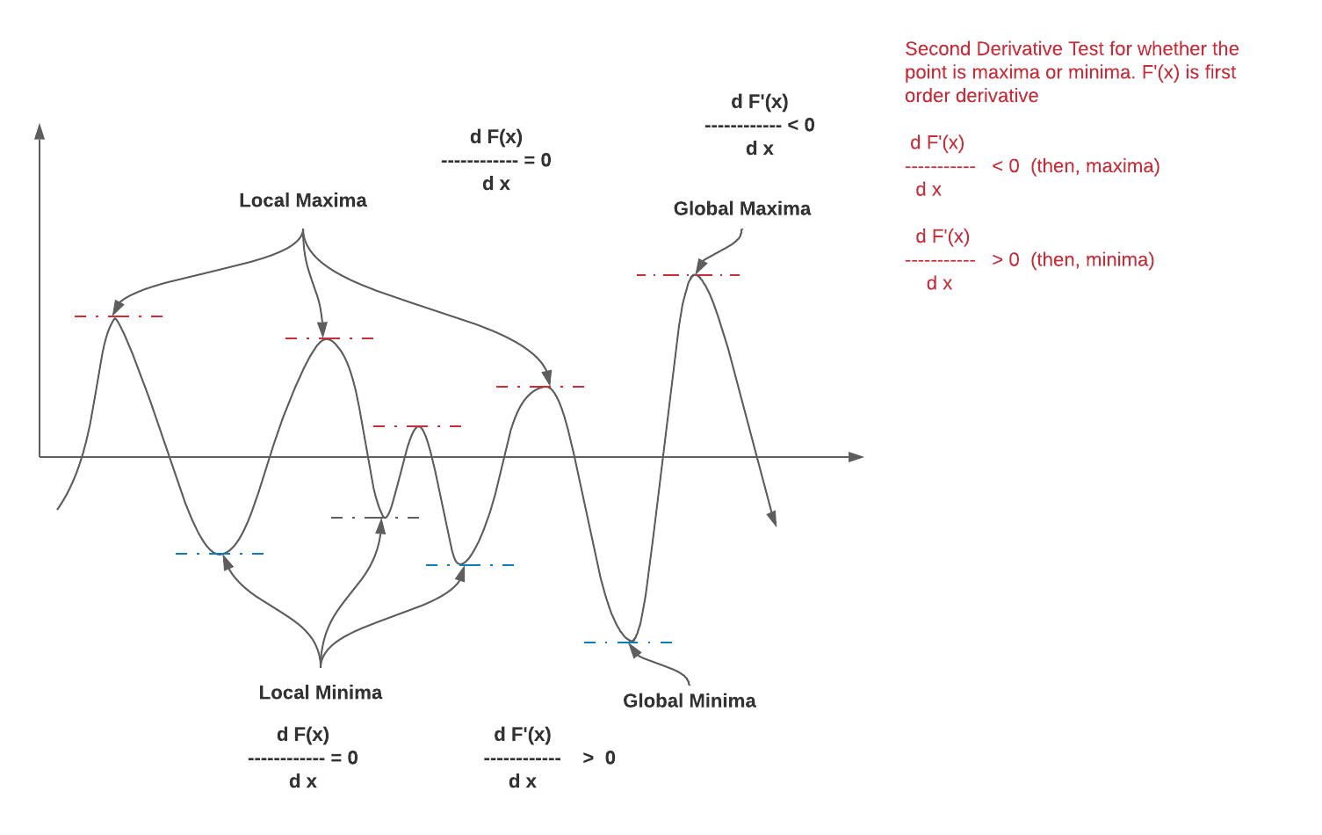
Find_Optimal;
Notes:
This is the first session so we will take it easy and go through some details regarding the curriculums and what is coming next. But I can assure you the following sessions are going to be far more interesting and you can expect a lot of extra fun details that was not included in the lectures.

Slide 9
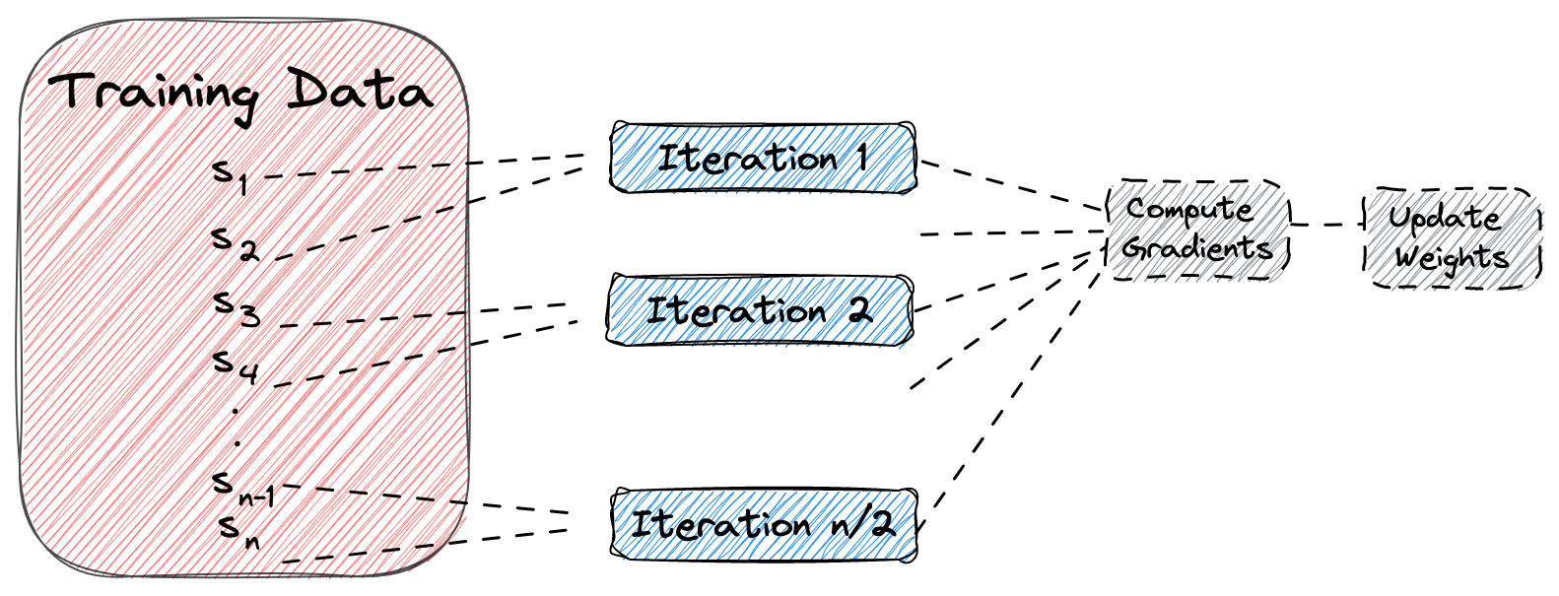
How_to_Gradient_Descent;
Notes:
This is the first session so we will take it easy and go through some details regarding the curriculums and what is coming next. But I can assure you the following sessions are going to be far more interesting and you can expect a lot of extra fun details that was not included in the lectures.

Slide 10
How_to_Gradient_Descent;
Notes:
This is the first session so we will take it easy and go through some details regarding the curriculums and what is coming next. But I can assure you the following sessions are going to be far more interesting and you can expect a lot of extra fun details that was not included in the lectures.

Slide 11
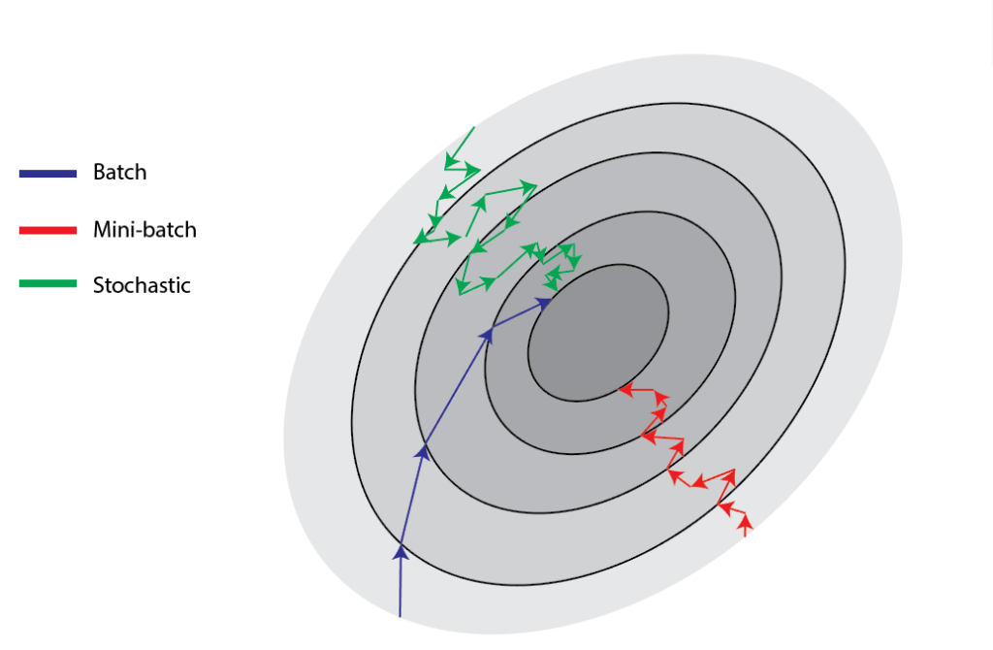
Batch_vs_stochastic_Mini-Batch;
Notes:
This is the first session so we will take it easy and go through some details regarding the curriculums and what is coming next. But I can assure you the following sessions are going to be far more interesting and you can expect a lot of extra fun details that was not included in the lectures.

Slide 12
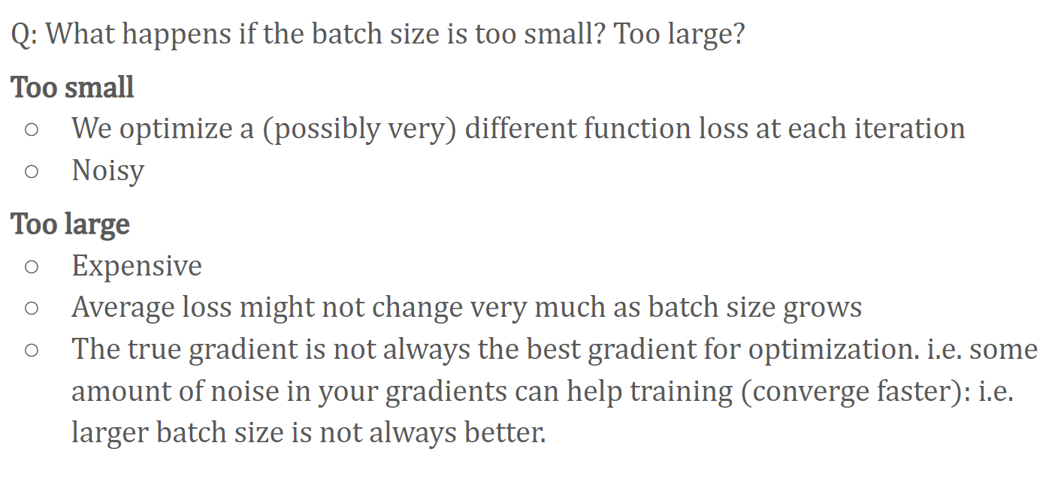
Batch_Size_is_Important;
Notes:
This is the first session so we will take it easy and go through some details regarding the curriculums and what is coming next. But I can assure you the following sessions are going to be far more interesting and you can expect a lot of extra fun details that was not included in the lectures.

Slide 13
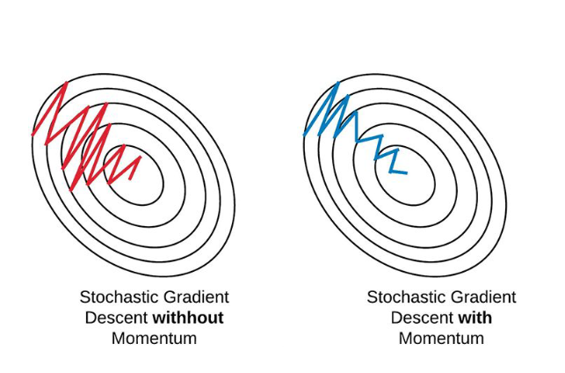
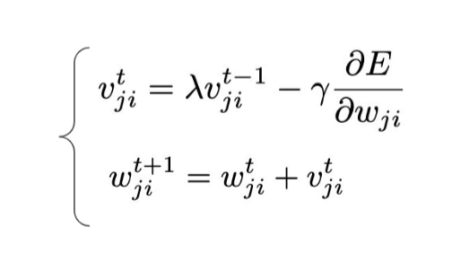
Momentum;
Notes:
The momentum term increases for dimensions whose gradients point in the same
directions and reduces updates for dimensions whose gradients change directions

Slide 14
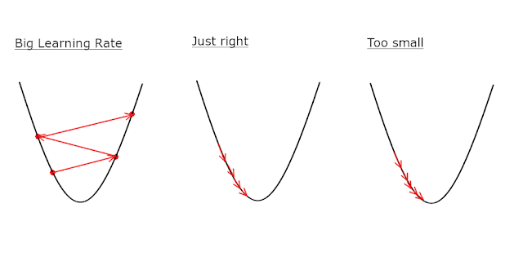
Learning_rate;
Notes:
The momentum term increases for dimensions whose gradients point in the same
directions and reduces updates for dimensions whose gradients change directions

Slide 15
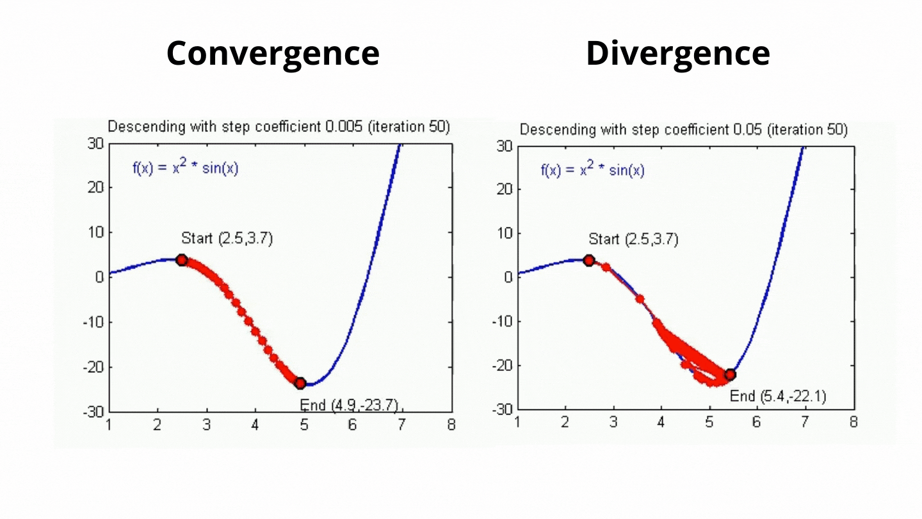
Learning_rate;
Notes:
The momentum term increases for dimensions whose gradients point in the same
directions and reduces updates for dimensions whose gradients change directions

Slide 16
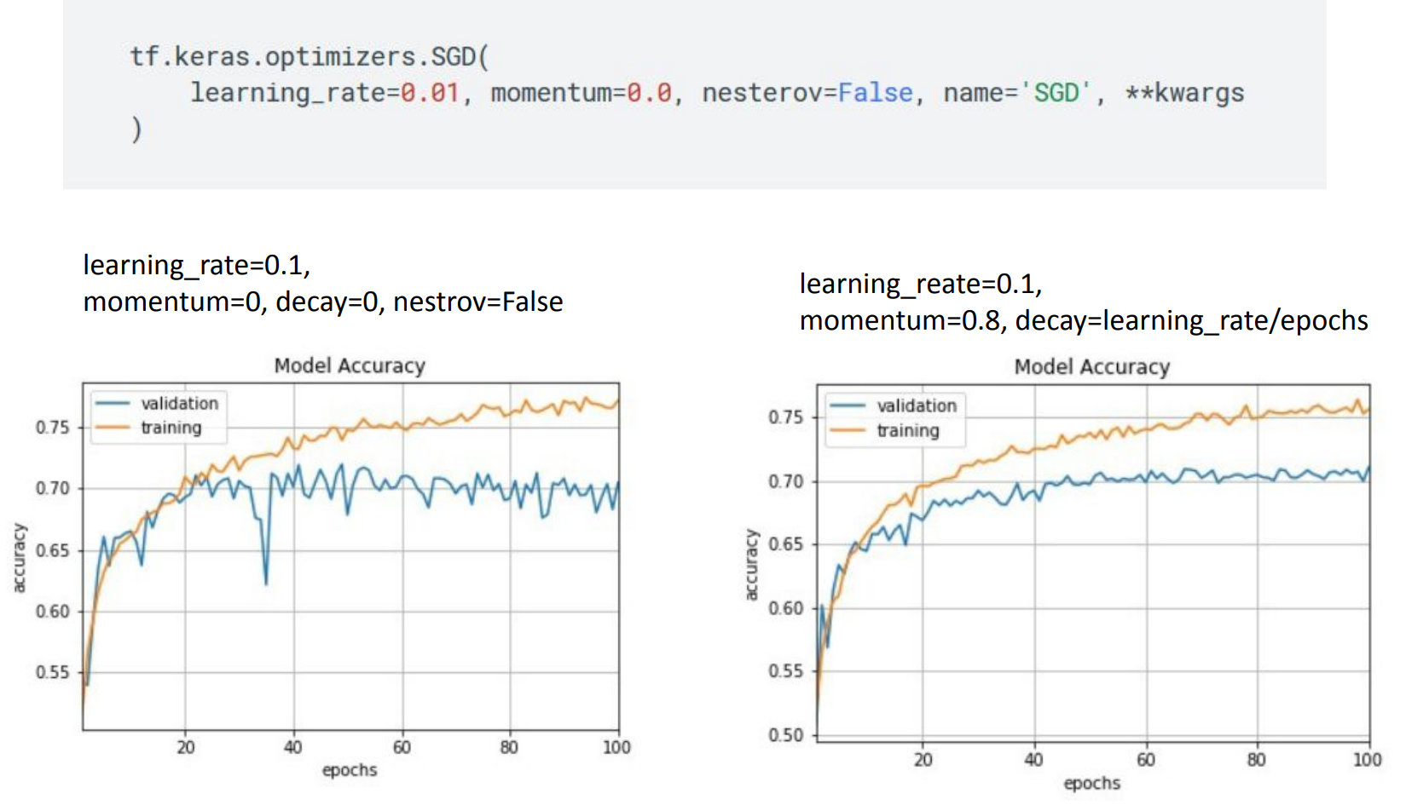
Learning_rate;
Notes:
The momentum term increases for dimensions whose gradients point in the same
directions and reduces updates for dimensions whose gradients change directions

Slide 17
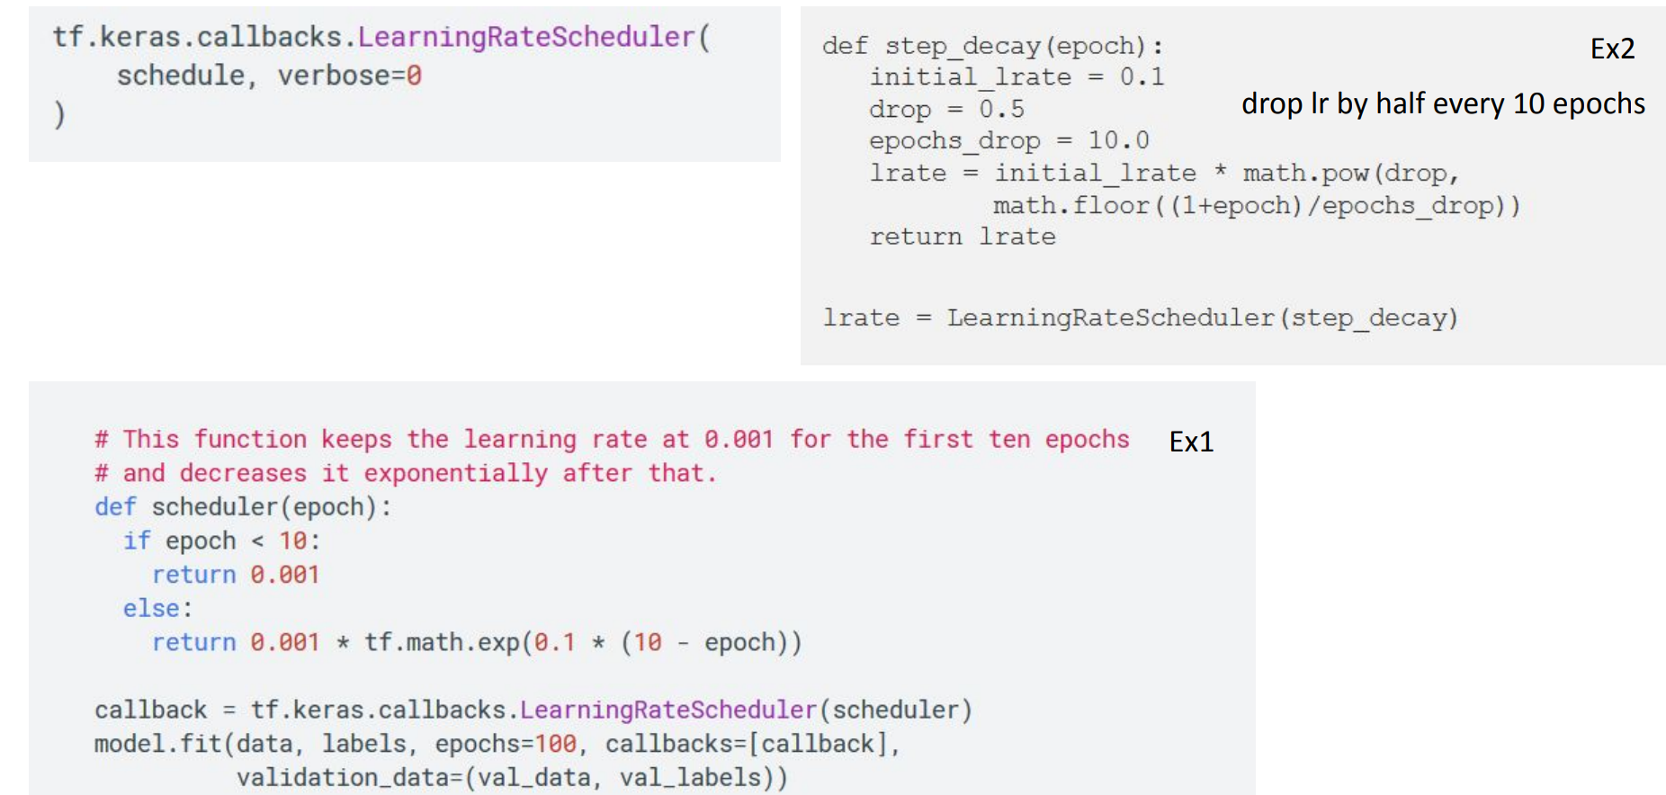
Learning_rate;
Notes:
The momentum term increases for dimensions whose gradients point in the same
directions and reduces updates for dimensions whose gradients change directions

Slide 18
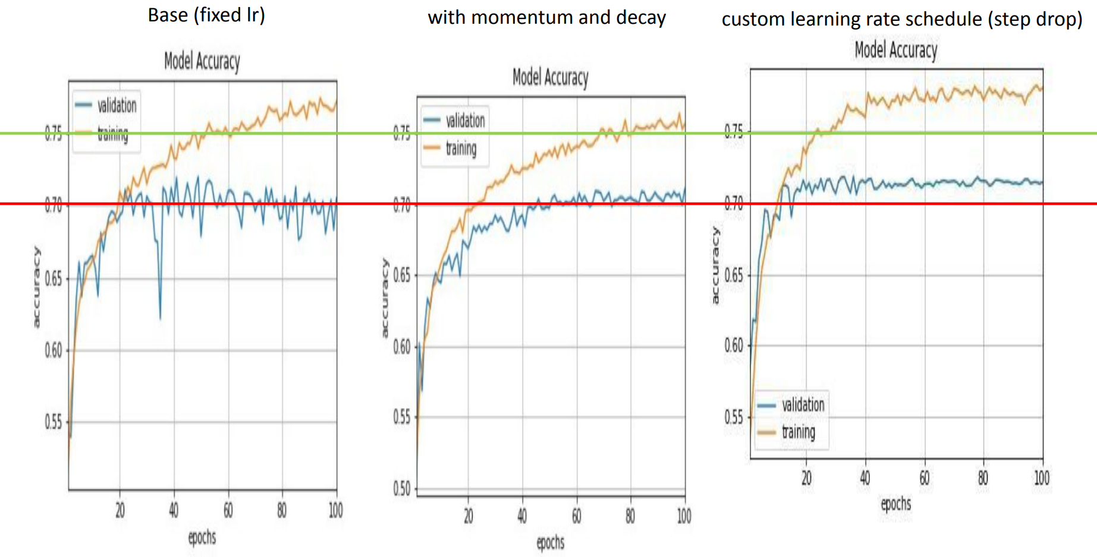
Learning_rate;
Notes:
The momentum term increases for dimensions whose gradients point in the same
directions and reduces updates for dimensions whose gradients change directions

Slide 19
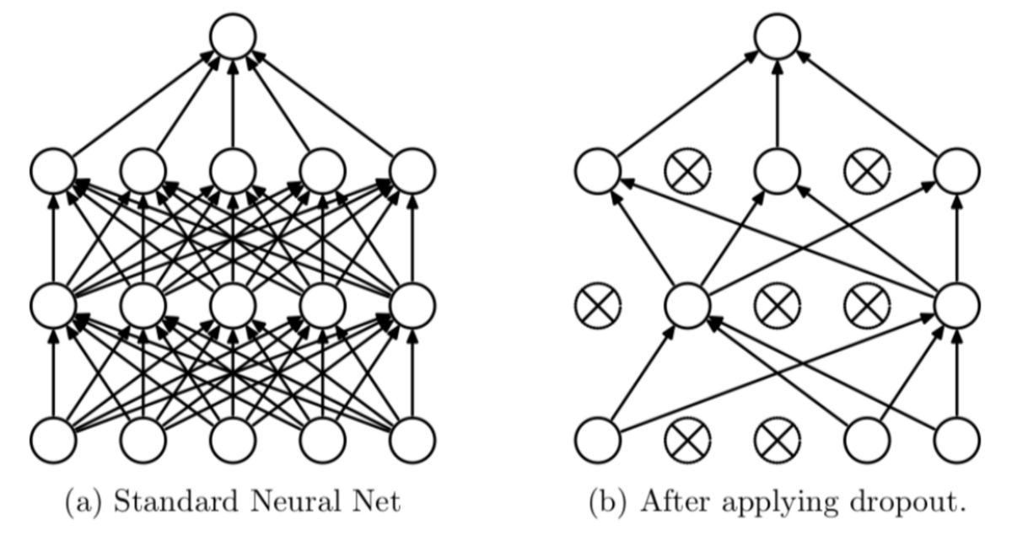
Regularization: Dropout;
Notes:
The momentum term increases for dimensions whose gradients point in the same
directions and reduces updates for dimensions whose gradients change directions

Slide 20
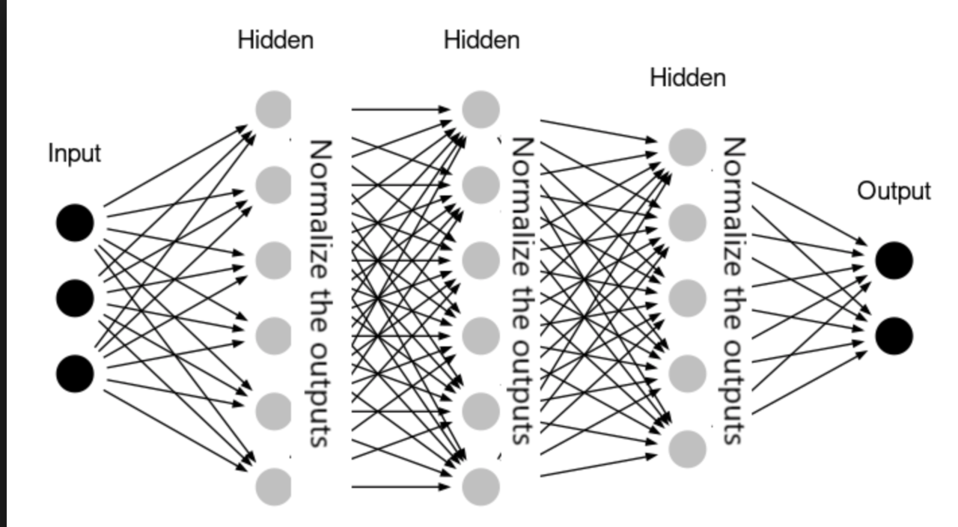
Regularization: Batch_Norm;
Notes:
The momentum term increases for dimensions whose gradients point in the same
directions and reduces updates for dimensions whose gradients change directions

Slide 21
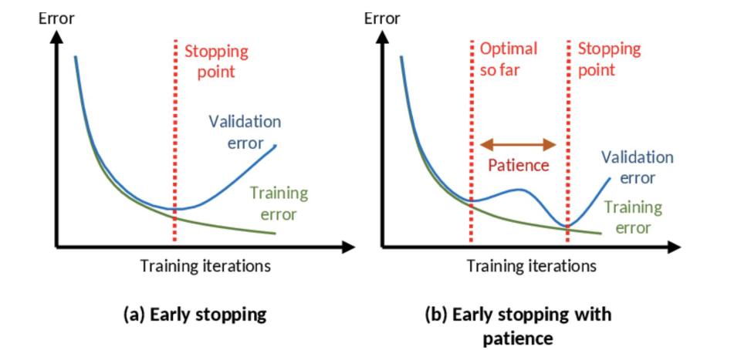
Early_stopping;
Notes:
The momentum term increases for dimensions whose gradients point in the same
directions and reduces updates for dimensions whose gradients change directions

Slide 22
Quiz!!!!!
Notes:
This is the first session so we will take it easy and go through some details regarding the curriculums and what is coming next. But I can assure you the following sessions are going to be far more interesting and you can expect a lot of extra fun details that was not included in the lectures.

Slide 23
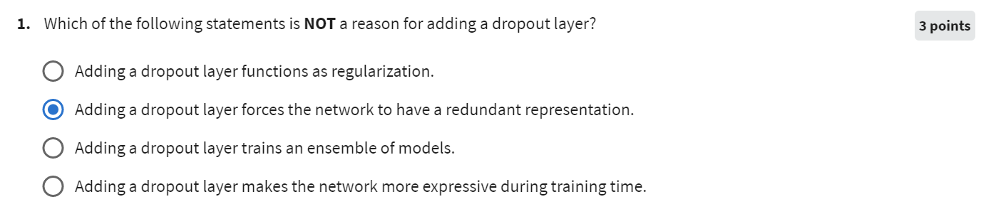
Quiz_Week_2_#1;
Notes:
This is the first session so we will take it easy and go through some details regarding the curriculums and what is coming next. But I can assure you the following sessions are going to be far more interesting and you can expect a lot of extra fun details that was not included in the lectures.

Slide 24
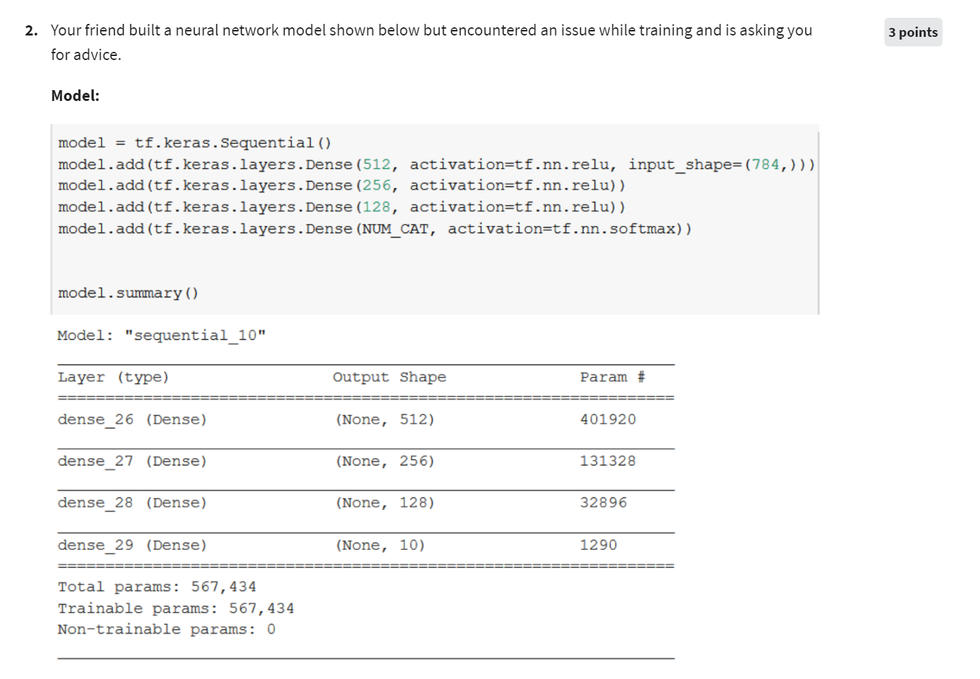
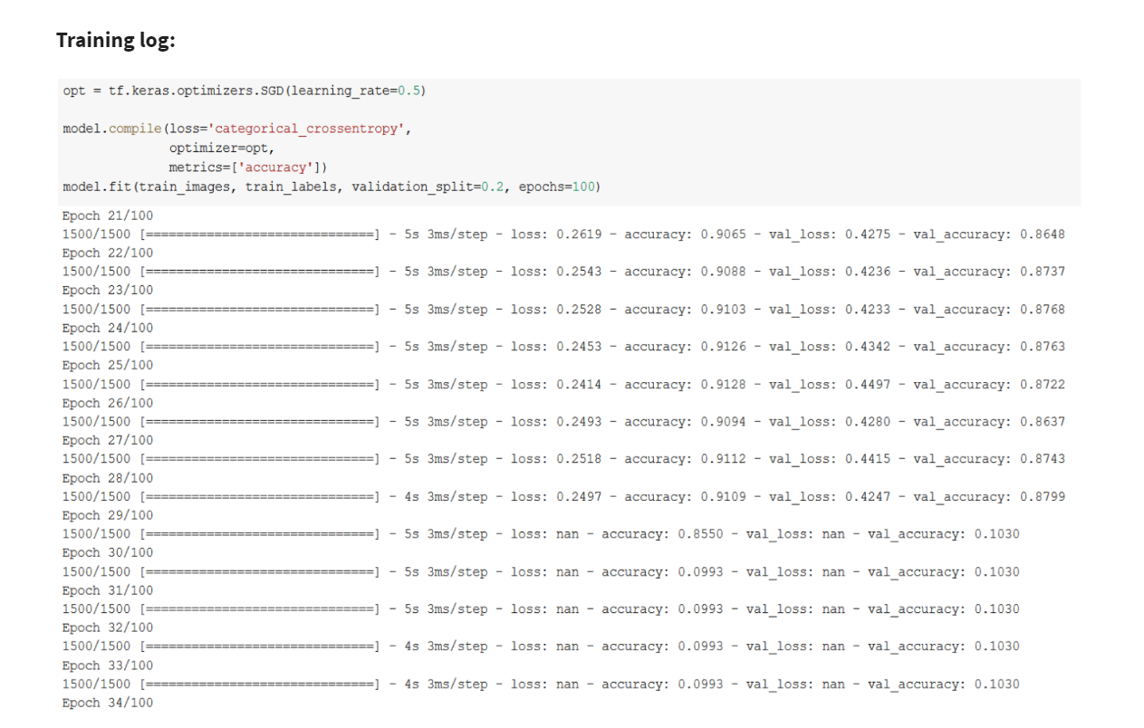
Quiz_Week_2_#1;
Notes:
This is the first session so we will take it easy and go through some details regarding the curriculums and what is coming next. But I can assure you the following sessions are going to be far more interesting and you can expect a lot of extra fun details that was not included in the lectures.

Slide 25
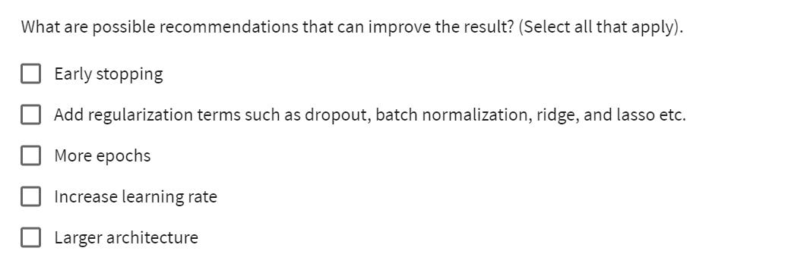
Quiz_Week_2_#1;
Notes:
This is the first session so we will take it easy and go through some details regarding the curriculums and what is coming next. But I can assure you the following sessions are going to be far more interesting and you can expect a lot of extra fun details that was not included in the lectures.

Slide 26
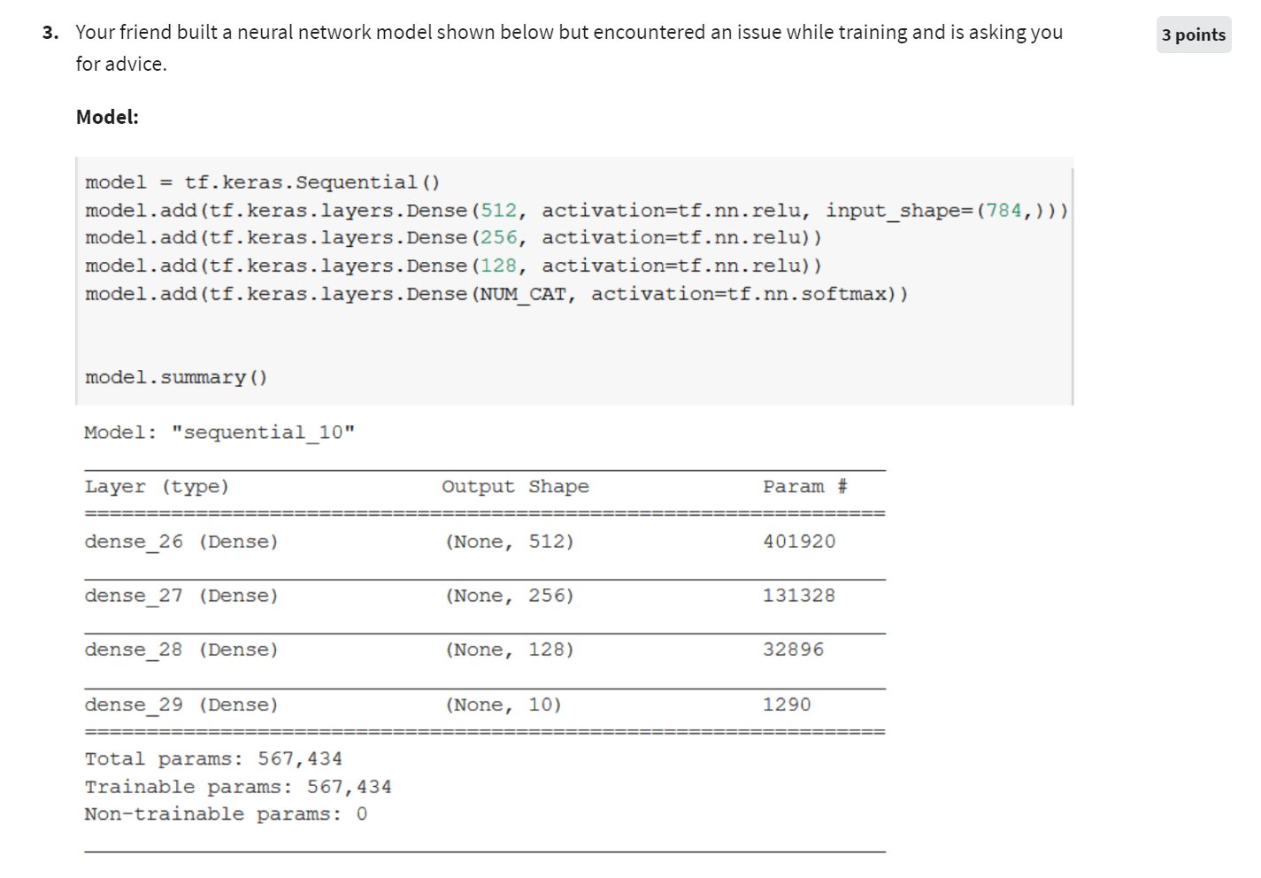
Quiz_Week_2_#1;
Notes:
This is the first session so we will take it easy and go through some details regarding the curriculums and what is coming next. But I can assure you the following sessions are going to be far more interesting and you can expect a lot of extra fun details that was not included in the lectures.

Slide 27
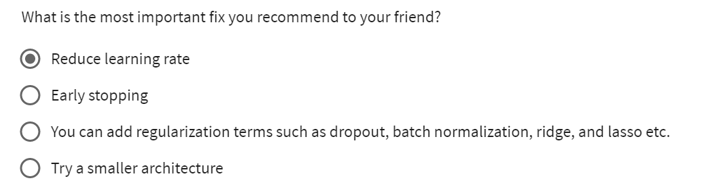
Quiz_Week_2_#1;
Notes:
This is the first session so we will take it easy and go through some details regarding the curriculums and what is coming next. But I can assure you the following sessions are going to be far more interesting and you can expect a lot of extra fun details that was not included in the lectures.

Slide 28
Next Session;
Full codes demo of Training loop (or project workshop)
CNN！！！
Full codes example of MLP
Kernels, paddings, stride
Poolings
Notes:
This is the first session so we will take it easy and go through some details regarding the curriculums and what is coming next. But I can assure you the following sessions are going to be far more interesting and you can expect a lot of extra fun details that was not included in the lectures.

